Slide 1
Addressing MISA Tooling Issues
Exploring different solution options

Slide 2
IBM Objectives
Reusable MISA asset
Meta-model – integrated with EA and Solution Design
Reference Model
Supporting Tooling
System Architect
RSA
Insight and Cognos Reporting
Community/Cloud BPM Projects
Workbenches
Open opportunities for EA, solution design and solution delivery for Smarter Cities

Slide 3
MISA Objectives
Tooling to manage MRMv2 models
Meta-model
Reference model
Instance models
MISA reporting and subscription modes
Collaboration tooling
Stakeholder appropriate workbenches
Asset management
Compare, Query, Reporting tools
Opportunity to share resources across communities
Ability to use instance models as source for IT development activities

Slide 4
Existing Tools
RSM for metamodel
SysML model with export to ReqPro requirement types
ReqPro for reference and instance municipal models
Matrix builder for editing relationships between entities
RRC to elaborate reference and instance models
Rich text
Business process, organization and use case diagrams
Lotus Quickr for collaboration
Places setup for each municipality
Ability to collaborate for review, approval and action on municipal transition initiatives
Focus mostly on strategic planning in this phase
Notes:
Questions:
Why was SysML chosen to build the metamodel instead of say plain UML or SoaML? Long term municipality vision, model content would be simulated. David Ing proposed SysML to support this simulation. But this would require the model to be in SysML, not the meta-model. RSA will have model execution with UAL and model execution.
Why was UML used for the metamodel instead of a UML profile? Business analyst wouldn’t want to use a UML profile or generate a UI. Goal was to have specialized metamodeler comfortable with UML, but they provide a different UI for business analyst. Issue was Web UI or simple UI for business analyst.
Why was ReqPro used to create the instance model instead of UML? Matrix capabilities? Web UI? Reporting? Because it had ReqWeb, and trace from/trace to matricies. Can’t have attributes on relationships though (cost, etc.). To get around that, built the matrix builder. Use Excel spreadsheet, put the relationship data in the cell. The create associative requirement type in ReqPro to represent the association with data.
Can Business Analyst (not Business User) use a rich client UI to develop the instance models consumed by the business user? OK with thick client if had to. WAN environment required. Web client preferred.
Would it be helpful if Quickr places could access live data instead of static published data as much as possible? Business user needs to modify some assets, collaborative environment, Business analysts works with authoritative models, business users should reflect changes and follow approval/governance process. No significant technical issues with Quickr Primary issues were technical issues getting tools to install, license, and run in WAN.
Why not use SA? Does natural. Cost too high (floating $9500, $2500 for web client). Too hard to use by municipality. But given the issues we have, may want to look for discounts. Would have to link to documents for rich text.

Slide 5
Tool Issues (current scope)
Complex, licensing initial tool and project setup
Challenges running rich client apps in a WAN
Limited or manual integration between tools
Meta-model and instance model
Model and rich text & graphics
Model and collaboration environment
Lack of data validation on import
Limited support for model diagrams
Limited Reporting, Querying and Scripting
Notes:
See SDW Technical Challenges.doc

Slide 6
Future Requirements (beyond current scope)
Interface suitable for a non-technical user
Need for multi-classification for more flexible organization, easier search - consider
Need for financial planning and reporting system
Need for easy modification, lifecycle management and compare/merge
Connect objective metrics to operational systems for feedback and portfolio management
Low cost
Availability for Municipal Pilots
Notes:
Issues taken from various MISA presentations

Slide 7
Solution Issues
How to export from MISA tools into solution development tools
Making the MISA models actionable
Reporting capabilities

Slide 8
Process Enablement
How to create initial municipal model
Import CSV file from existing assets
Use matrix editor to edit relationships

Slide 9
Governance Issues
Lifecycle management of meta, reference and instance models
Data validation
Process enactment

Slide 10
Moving Forward
Key requirements to address:
Strategic Planning (what to do with the municipal models)
Connection to IT architecture (for solution design/development)
Lifecycle Management and Governance
Accessibility, consumability (install, license, update, WAN access, Web Access)
Cost

Slide 11
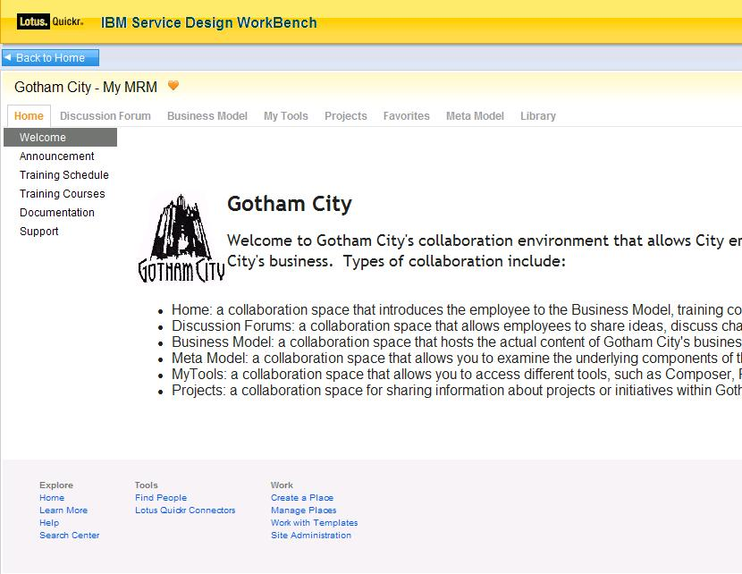
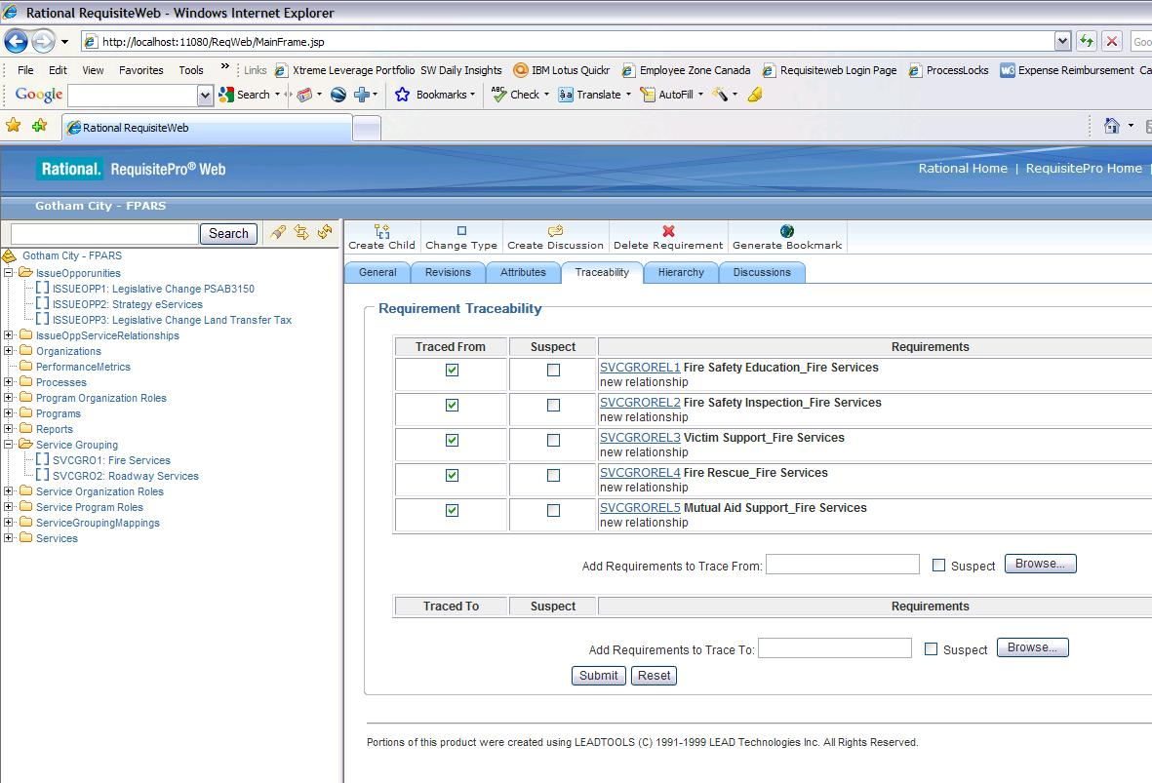
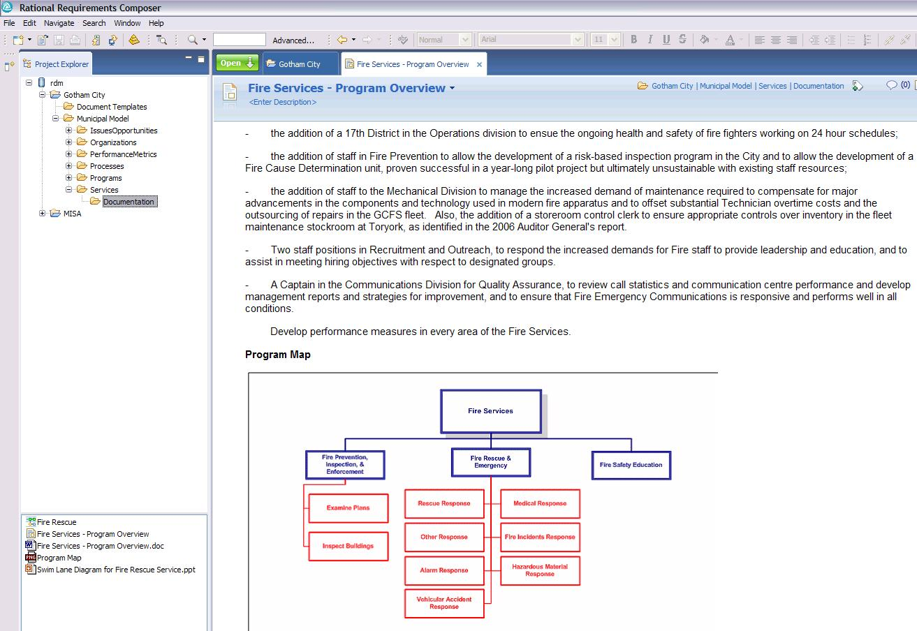
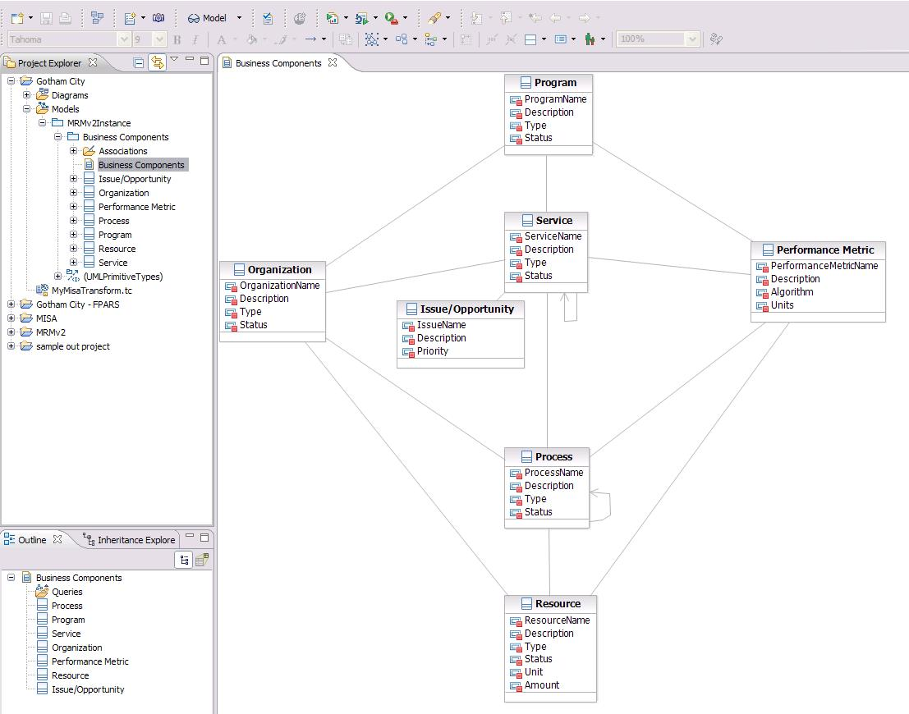
SDW Option 1: Evolve Current Tooling Architecture
Business User
Business Analyst
Meta Modeler
Rational RequisitePro
Rational Requirements Composer
Lotus Quickr
Rational Software Modeler
ReqPro
Create & manage business components
Build relationships between components
Query business components
Compare business components in one municipality or across municipalities
Import/Export business component matrices
RRC
Elaborate on business components with documents, BPM diagrams, UC diagrams
Review business component content published from ReqPro, RRC, RSM
Collaborate – forums, wikis
Create and extend MRM meta-model
Compare meta models (versions of one municipality or across municipalities)

Slide 12
SDW Option 1: Assessment
Address install, update, licensing with scripts or VM image clone
Address usability issues with convenience menu items and integration scripts
Hide import/export with “edit/save” where possible
Solution is available for pilot now
But this is not a strategic solution
Doesn’t address lifecycle management
Doesn’t support strategic planning
Not well positioned for EA or solution design/delivery
High dependency on tooling that is not designed for modeling

Slide 13
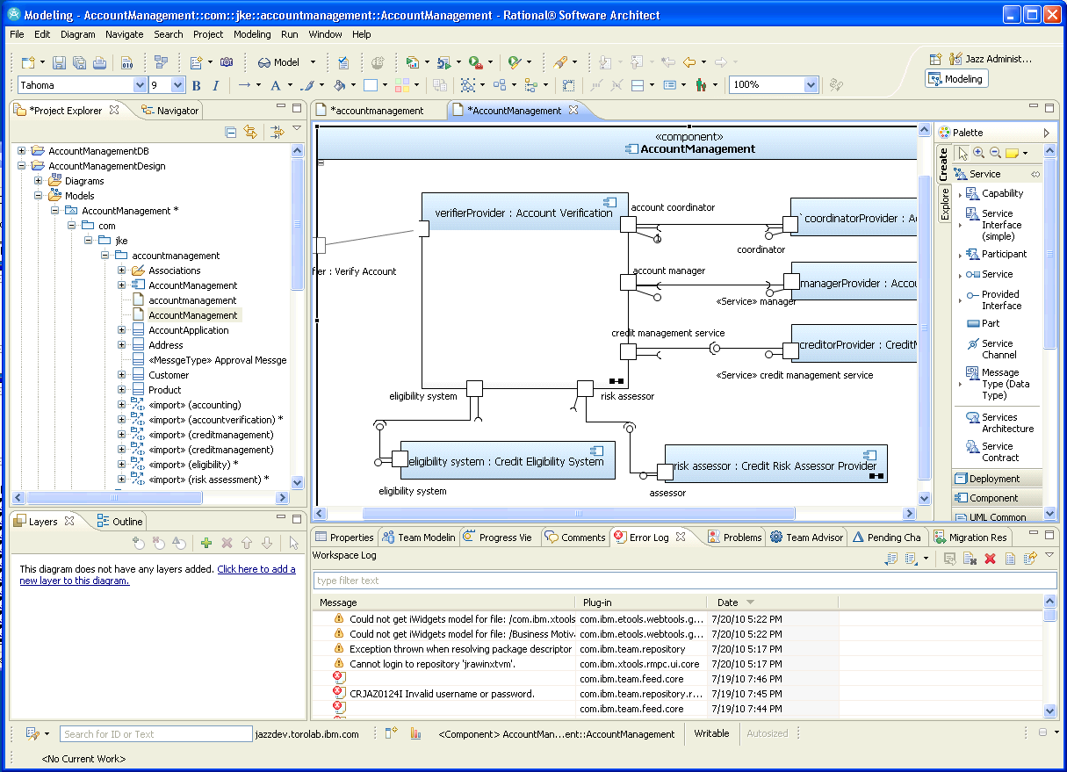
SDW Option 2: Tooling Architecture based on RSx - Triton
Business User
Business Analyst
Meta Modeler
Lotus Quickr
Rational Software Modeler, (CAM), RAM, RPE
Rational Software Modeler
Create & manage business components
Build relationships between components
Query business components
Compare business components in one municipality or across municipalities
Import/Export business component matrices
Elaborate on business components with documents, BPMN diagrams, UC diagrams
Review business component content published from RSx
Collaborate – forums, wikis
Create and extend MRM meta-model
Compare meta models (versions of one municipality or across municipalities)

Slide 14
SDW Option 2: Assessment
Do meta-model using UML profile
Generate tooling UI from UML profile
Instance model is a UML model with applied profile
Can exploit SysML and/or SoaML for services modeling, BMM for business motivation and strategy
BIRT and Insight for reporting
Similar solution for matrix/spreadsheet editing
Direct support for diagrams and rich text documents
Integration with WebSphere Business Modeler
Mostly single tool solution but with limited Web UI
RSx 8 and CAM 3.0 provide read-only web access and review, markup and commenting
Good solution if downstream IT development and deployment is primary value proposition

Slide 15
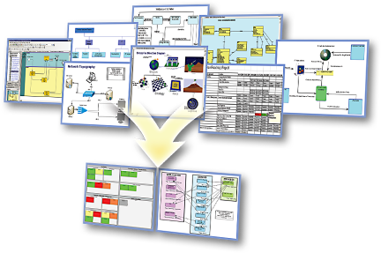
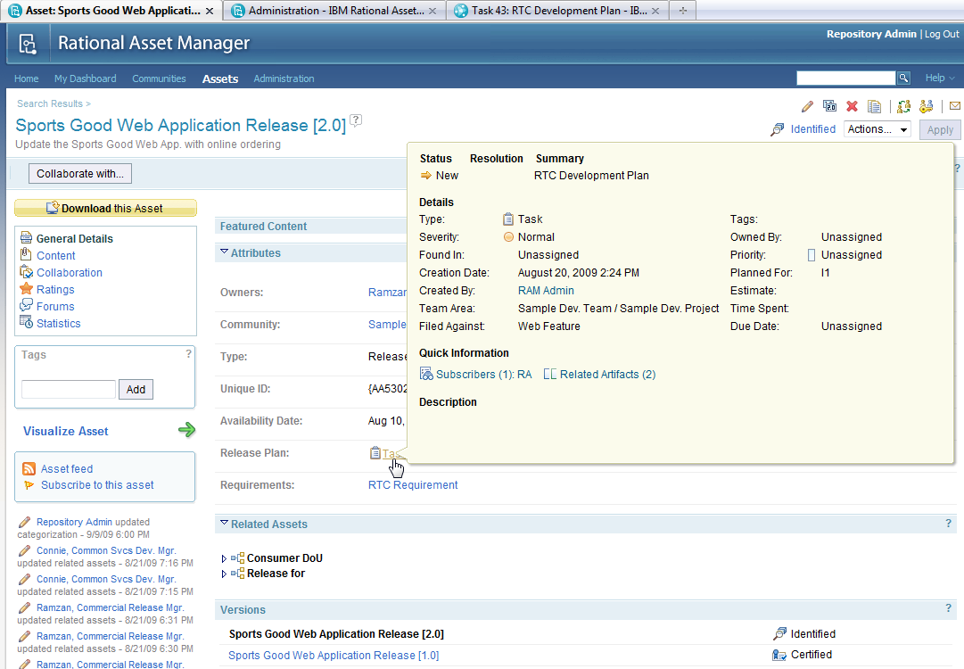
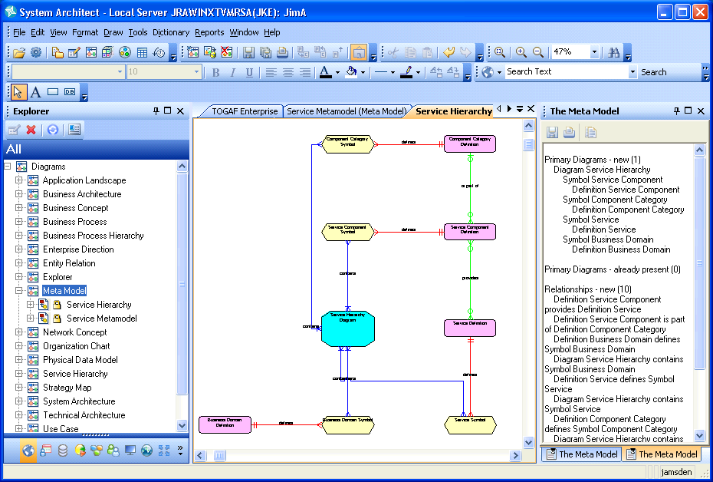
SDW Option 3: Rational System Architect
Business User
Business Analyst
Meta Modeler
Rational System Architect, SA/XT, RAM, RPE
Rational System Architect Extensibility
Lotus Quickr
Create & manage business components
Build relationships between components
Query business components
Compare business components in one municipality or across municipalities
Import/Export business component matrices
Elaborate on business components with documents, BPMN diagrams, UC diagrams
Review business component content published from SA
Collaborate – forums, wikis
Create and extend MRM meta-model
Compare meta models (versions of one municipality or across municipalities)

Slide 16
SDW Option 3: Assessment
Meta-model and models are in a single tool
Supports lifecycle management through workspaces
Integrates with Focal Point for strategic planning
Integrates with Cognos for Business Intelligence
Supports explorer, data forms, diagram and matrix views
SA/XT provides Web interface with limited editing capability
Powerful, flexible query mechanism, explorer diagrams and reporting
Highly customizable for stakeholder viewpoints
Supports model compare/merge
Provides support for enterprise architecture including business and IT architecture for solution design
Good solution if strategic planning is the primary value proposition
Notes:
+ SA has a rich client UI, and a Web UI using SA/XT that also supports model editing
+ SA supports integrated explorer, data entry form, diagram and matrix views on model data as well as free-form views
+ SA provides rich, extensible matrix views and additional views can be created by end users in support of particular stakeholder needs
+ SA is highly customizable even by end users (for opportunistic metamodel extensions)
+ SA has a powerful, flexible query mechanism
+ The supporting tool set is resulting in the installation of less tools (SA and SA/XT)
+ Information is integrated into a single repository accessed by different tools reducing lifecycle management burden and costs
+ Lifecycle management is supported by workspaces and compare merge of model content
+ Information redundancy can be managed as needed
+ The MRM business motivation and strategy, and business architecture parts of EA can be easily extended or integrated with other content and capabilities to support the rest of the EA (application, data and technical architectures) for the next phase of use cases
- Editing the metamodel with SA USERPROPS is not as easy as editing a UML model. This may be inproved in 11.4.1 with the introduction of a metmodel editor extension to visually create the metamodel extensions. (That capability may be available for internal use now).
+ Metamodel extensibility includes support for explorers, forms, matrixes, diagrams and reports, not just the metamodel classes
+ SA has a number of different reporting options that can be used
+ SA/XT can be integrated with Quickr to provide collaboration on live MRM data, not just published, potentially stale data
- SA rich client UI may not be appropriate for many business analysts and SA/XT has limited editing capabilities
+ SA integration with Focal Point would provide a capability to objectively analyze different MRM project alternatives
+ Some elements of the existing SA TOGAF and/or TeamSD metamodels could be used to enhance and extend the existing MRM metamodel and tools, as well as address more of the MRM business use cases.
- No support for sketching and storyboards directly in SA

Slide 17
Addressing the Issues
Issue | Addressed By
Complex, licensing initial tool and project setup | Reduction in number of tools. SA replaces RSM, ReqPro and RRC
Challenges running rich client apps in a WAN | Same problem with all options. SA runs in Remote Desktop Connection with floating license
Limited or manual integration between tools Meta-model and instance model Model and rich text & graphics Model and collaboration environment | All models in SA. SA extensibility used to update metamodel. SA and SA/XT used to view and edit models. Uses SA browser, definitions, diagrams, matrices, explorer diagrams
Lack of data validation on import | Eliminate as much as possible import/export as a means of integrating tools
Limited support for model diagrams | SA has support for many standard diagrams, explorer diagrams (from reports) and can have custom diagrams
Limited Reporting, Querying and Scripting | SA supports queries, HTML and Office reports, SA Publisher, Insight and Cognos reporting, and RPE

Slide 18
Addressing the Issues (cont.-)
Issue | Addressed By
Interface suitable to different stakeholders | SA rich client for business architect, SA/XT for business architect and user, Quickr for collaboration
Support for flexible classification | SA supports categorization of model elements, and/or use RAM
Strategic Planning | SA integration with Focal Point provides: Project Portfolio Management Strategic alignment with business objectives Assessment of costs, risks, NPV, time to value Project roadmaps and resource allocation
LIfecycle Management | SA has versioning for definitions, and workspaces for different work streams. Supports compare and merge to manage changes. RAM for asset management and governance
Cost | Incremental difference in cost for each solution option. Actual cost depends on potential use of Cloud subscription model. Needs further investigation
Availability | Existing solution would need to be migrated to chosen option

